Slide 1
COMPUTER ARITHMETIC
Floating Point Representation
Computer Science Department
National University of Computer and Emerging Sciences
Islamabad
Notes:
1

Slide 2
REAL NUMBERS
Numbers with fractions
Could be done in pure binary
1001.1010 = 2⁴ + 2⁰ +2⁻¹ + 2⁻³ =9.625
Where is the binary point?
Fixed?
Very limited
Moving?
How do you show where it is?
Notes:
2

Slide 3
FLOATING POINT NOTATION
Decimal
12.4568_{ten} (decimal notation) means
10*1 + 2 + 4/10 + 5/100 + 6/1000 + 8/10000
In scientific notation
12.4568 =
124568 * 10⁻⁴ = 1245680 * 10⁻⁵ =
12456.8 * 10⁻³ = 1245.68 * 10⁻² =
124.568 * 10⁻¹ =12.4568 * 10⁰
1.24568 * 10¹
1.24568*10¹ is an example of normalised scientific notation.
Notes:
3

Slide 4
FLOATING POINT IN BINARY
Binary
0.010011_{two} =
(0/2) + (1/2²) + (0/2⁴) +(1/2⁵) + (1/2⁶)
0 + 1/4 + 0 + 1/32 + 1/64 =
(0.25 + 0.03125 + 0.015625)_{ten} =
0.296875_{ten}
In scientific notation
10011*2⁻⁶ = 1001.1*2⁻⁵ =
100.11*2⁻⁴
1.0011*2⁻² normalised
Notes:
4

Slide 5
NORMALIZATION
Every binary number, except the one corresponding the number zero, can be normalized by choosing the exponent so that the radix point falls to the right of the leftmost 1 bit.
37.25₁₀ = 100101.01₂ = 1.0010101 x 2⁵
7.625₁₀ = 111.101₂ = 1.11101 x 2²
0.3125₁₀ = 0.0101₂ = 1.01 x 2⁻²

Slide 6
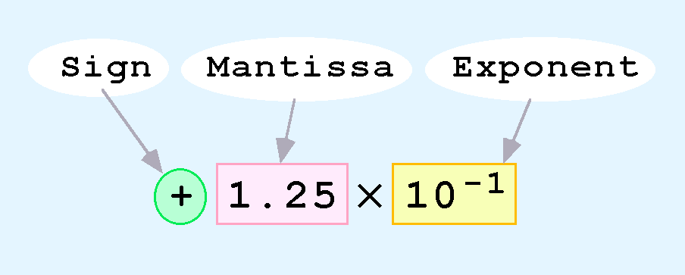
FLOATING-POINT REPRESENTATION
Computers use a form of scientific notation for floating-point representation
Numbers written in scientific notation have three components:
Notes:
6

Slide 7
FLOATING POINT
Sign bit
Biased
Exponent
Significand or Mantissa
+/- .significand x 2^{exponent}
Point is actually fixed between sign bit and body of mantissa
Exponent indicates place value (point position)
Notes:
7

Slide 8
FLOATING-POINT STANDARDS
The IEEE has established a standard for
floating-point numbers
The IEEE-754 single precision floating point
standard uses an 8-bit exponent (with a bias of 127) and a 23-bit significand. Bias is 2^{k-1}-1
The IEEE-754 double precision standard uses an 11-bit exponent (with a bias of 1023) and a 52-bit significand.
Notes:
8

Slide 9
FLOATING-POINT REPRESENTATION
In both the IEEE single-precision and double-
precision floating-point standard, the significand has an implied 1 to the LEFT of the radix point.
The format for a significand using the IEEE format
is: 1.xxx…
For example, 4.5 = .1001 x 2³ in IEEE format is 4.5 = 1.001 x 2².
The 1 is implied, which means it does not need to be
listed in the significand (the significand would include
only 001).
Notes:
9

Slide 10
FLOATING-POINT REPRESENTATION
Example: Express -3.75 as a floating point number
using IEEE single precision.
First, let’s normalize according to IEEE rules:
-3.75 = -11.11₂ = -1.111 x 2¹
The bias is 127, so we add 127 + 1 = 128 (this is our
exponent)
The first 1 in the significand is implied, so we have:
Since we have an implied 1 in the significand, this equates to
-(1).111₂ x 2 ^{(128 – 127)} = -1.111₂ x 2¹ = -11.11₂ = -3.75.
(implied)
Notes:
10

Slide 11
DECIMAL FLOATING POINT TO IEEE STANDARD CONVERSION
Ex 1: Find the IEEE FP representation of 40.15625
Step 1.
Compute the binary equivalent of the whole part and the fractional part. (i.e. convert 40 and .15625 to their binary equivalents)

Slide 12
DECIMAL FLOATING POINT TO IEEE STANDARD CONVERSION
40 .15625
Result: Result:
101000 .00101
So: 40.15625₁₀ = 101000.00101₂

Slide 13
DECIMAL FLOATING POINT TO IEEE STANDARD CONVERSION
Step 2. Normalize the number by moving the decimal point to the right of the leftmost one.
101000.00101 = 1.0100000101 x 2⁵

Slide 14
DECIMAL FLOATING POINT TO IEEE STANDARD CONVERSION
Step 3. Convert the exponent to a biased exponent
127 + 5 = 132
And convert biased exponent to 8-bit unsigned binary:
132₁₀ = 10000100₂

Slide 15
DECIMAL FLOATING POINT TO IEEE STANDARD CONVERSION
Step 4. Store the results from steps 1-3:
Sign Exponent Mantissa
(from step 3) (from step 2)
0 10000100 01000001010000000000000

Slide 16
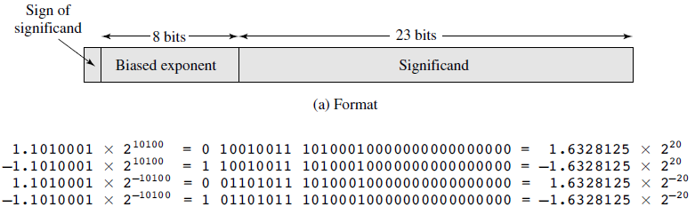
FLOATING POINT EXAMPLES
Notes:
16
.6328125-> binary( 101000100000)
Bias= 2^{k-1}-1
K=8
Bias=2⁷-1=127
Base=20
Add Bias= 147=10010011
For 1.6328125x2⁻²⁰
Bias= -20+127=107=(01101011)₂

Slide 17
FP RANGES
For a 32 bit number
8 bit exponent (-127 to 128)
24 bit fraction ( -(1-2⁻²⁴) to (1-2⁻²⁴))
Notes:
17

Slide 18
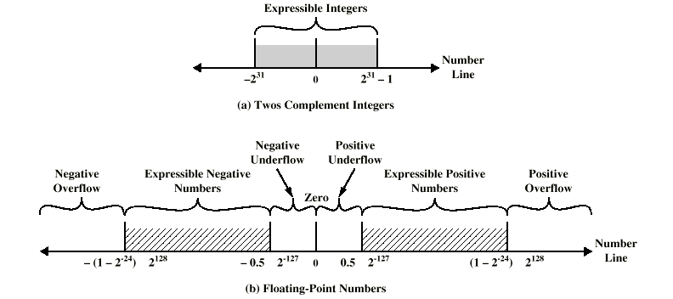
EXPRESSIBLE NUMBERS
Notes:
18

Slide 19
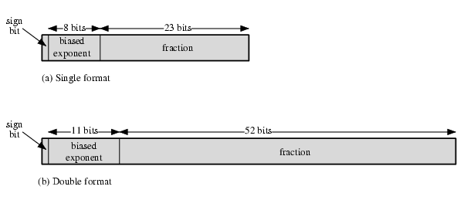
IEEE 754 FORMATS
Notes:
19

Slide 20
IEEE 754
Standard for floating point storage
32 and 64 bit standards
8 and 11 bit exponent respectively
Extended formats (both mantissa and exponent) for intermediate results
Notes:
20

Slide 21
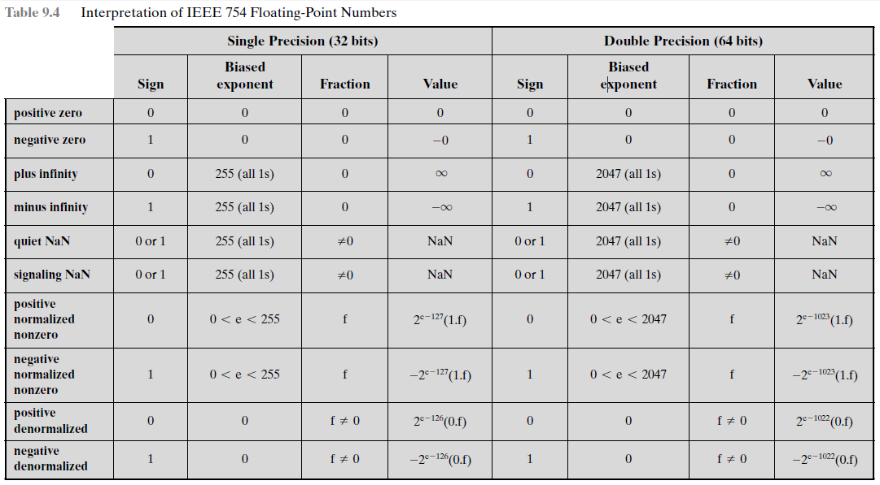

Slide 22
FP ARITHMETIC +/-
Check for zeros
Align significands (adjusting exponents)
Add or subtract significands
Normalize result
Notes:
22

Slide 23
FP ARITHMETIC X/÷
Check for zero
Add/subtract exponents
Multiply/divide significands (watch sign)
Normalize
Round
All intermediate results should be in double length storage
Notes:
23

Slide 24
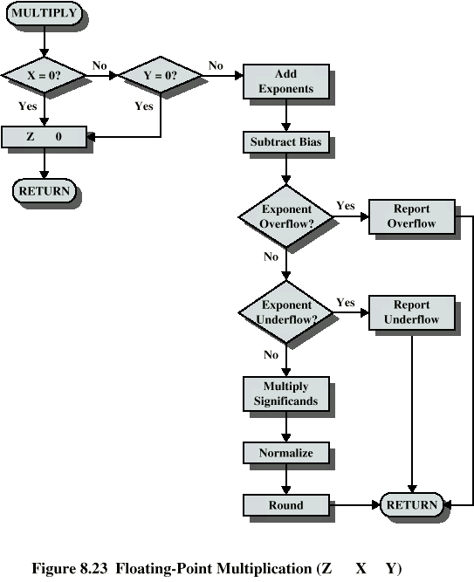
FLOATING POINT MULTIPLICATION
Notes:
24

Slide 25
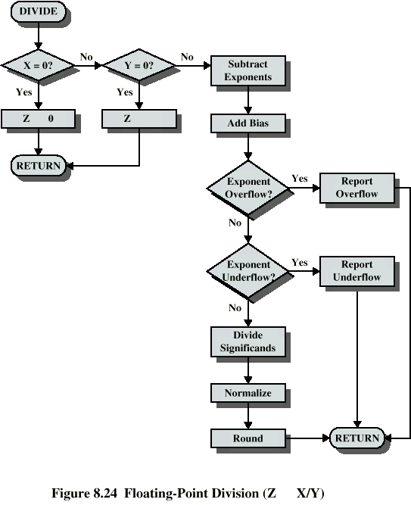
FLOATING POINT DIVISION
Notes:
25

Slide 26
REQUIRED READING
Stallings 8th Edition Chapter 9
Stallings 9th Edition Chapter 10
IEEE (Institute of Electrical and Electronics
Engineers) Computer 754 on IEEE Web site
Notes:
26

